Slide 1
Project Result 1 Training Package for Sustainability in Social Enterprises
Module 3 – Cause Marketing
Developed by Future in Perspective Ltd

Slide 2
Project information
EMPOWER PROJECT
Social Enterprises' Sustainability Tools
Key Action 2: KA220-YOU - Cooperation partnerships in youth
Project number: 2021-1-BG01-KA220-YOU-000029024
Period of the project implementation: 02/01/2022 - 02/01/2024 (2 Years)
Consortium: BRCCI (BG); SERN (IT); KMOP(GR); Future in Perspective Ltd (IE); CARDET (CY); Innovade LI (CY); Mindshift Talent Advisory (PT).

Slide 3
Aims of this module
Key content areas
Explain the term cause marketing
Present the benefits of cause marketing
Showcase how to implement cause marketing for your social enterprise
Give examples of cause marketing

Slide 4
Learning outcomes of this module
By the end of this module, you will be able to:
Understand cause marketing and identify the different forms of cause marketing
Understand the different benefits of cause marketing
Understand how to implement cause marketing in your own social enterprise

Slide 5
Unit 1 What is cause marketing?

Slide 6
Cause Marketing
Cause marketing is a form of Corporate Social Responsibility (‘CSR’) in which a company can support a cause that betters society while helping to increase a brand’s profitability.
There are three different forms of cause marketing:
Cause promotions – company-funded advocacy campaigns that are usually self-interest motivated. Examples would be organic food companies partnering with an anti-pesticide campaign.
Corporate social marketing – campaign intended to promote behavioural changes intended to improve public health, safety, or the environment.
Cause-related marketing – where a company offers to make a charitable donation for the customer based on product sales.

Slide 7
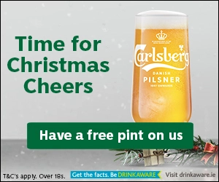
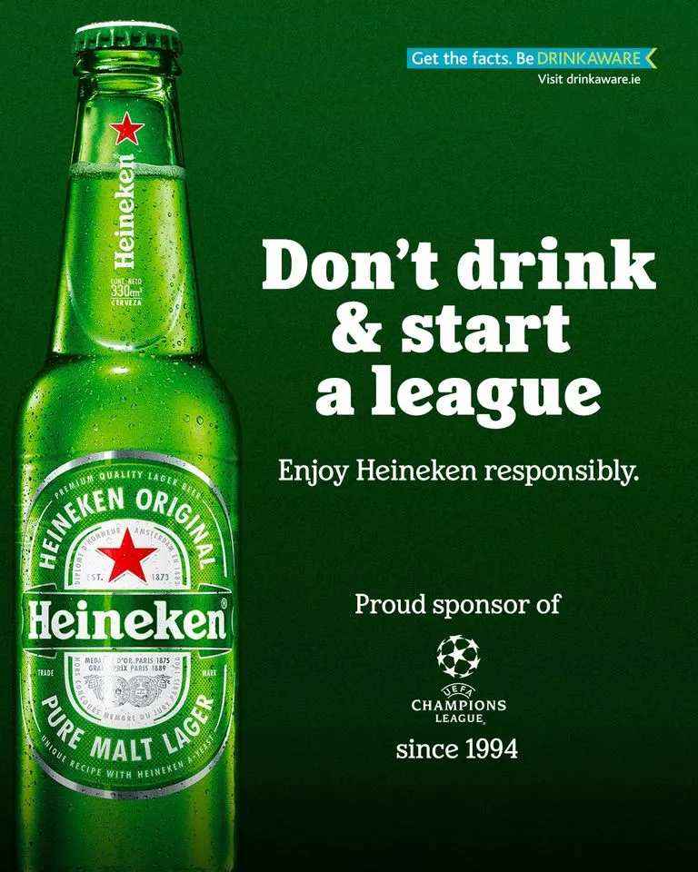
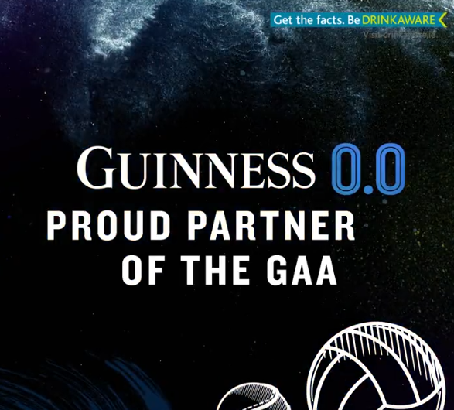
Case Study #1 - Drinkaware
Drinkaware is a charity aimed at promoting healthy alcohol consumption habits in Ireland. Drinkaware has registered their logo as a trademark.
Companies can apply to use the Drinkaware logo provided they fit requirements set forth by the charity.
Many alcohol companies have partnered with Drinkaware to use their logo in their Irish advertisements such as Carlsberg and Heineken.
Image sources: https://drinkawastedotie.files.wordpress.com/2020/12/carlsberg-free-pints.jpg?w=300
https://drinkawastedoteu.files.wordpress.com/2021/04/heineken-drinkaware-champions-league.jpg?w=768
https://drinkawastedotie.files.wordpress.com/2022/06/guinness-proud-partner-of-the-gaa.png

Slide 8
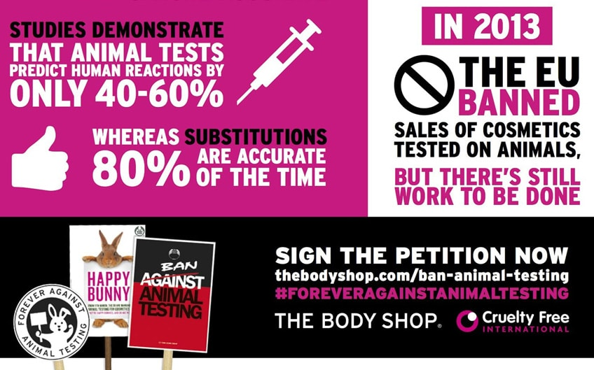
Case Study #2 – The Body Shop
In 2017, The Body Shop (a cosmetics brand) joined forces with Cruelty Free International to promote a global ban on animal testing for cosmetics.
The partnership runs advertising campaigns fighting against animal testing, and promote petitions calling for national and international bans on animal testing.
The Body Shop has been cruelty free since they were established in 1989.
Image source: The Body Shop (2017)

Slide 9
Case Study #3 – Lidl & Jigsaw
Since 2018, Lidl Ireland has been partnered with youth mental health charity Jigsaw.
Throughout this cause marketing campaign, Lidl has started a number of initiatives aimed at promoting good mental health practices amongst young people:
OneGoodManager – aimed at Lidl employees
OneGoodClub – a partnership with Ladies GAA to promote good mental health amongst young women
OneGoodSchool – supports the mental health and wellbeing of young people in schools
OneGoodAdult – teaches adults the importance of talking to young people about mental health
Every year on October 10th (World Mental Health Day), Lidl donates a dedicated amount from every sale of designated products.
Image source: https://www.lidl.ie/jigsaw

Slide 10
Discussion Time
Activity 1
Split into pairs!
You have three minutes to discuss each of the following questions.
Think of the three case studies you just learned about. Can you identify which type of cause marketing was used in each case?
Can you think of any other examples of cause marketing campaigns?
What do you think the benefits of cause marketing can be for a social enterprise?

Slide 11
Unit 2 Benefits of Cause Marketing

Slide 12
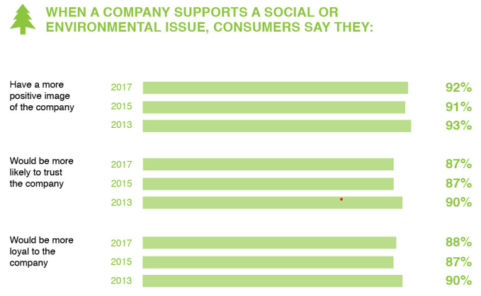
Benefits of Cause Marketing
There are many benefits of engaging in cause marketing for both social enterprises and companies.
In 2019, it was found that 70% of consumers want to know what the brands they purchase from are doing about social and environmental issues (Schaeffer, 2019).
Nearly 50% of consumers report to pay close attention to a brand’s social responsibility efforts when they buy a product (Shaeffer, 2019).
Image source: (Cone Communications, 2017) https://www.cbd.int/doc/case-studies/inc/cs-inc-cone-communications-en.pdf

Slide 13
Benefits of Cause Marketing
Creates authentic engagement
72% of consumers believe that it is “more important than ever” to buy from companies that reflect their values (Moore, 2020)
Connects with the community
This can connect with both local communities and/or certain societal communities such as young people, women, LGBTQIA+, etc. (Indeed Editorial Team, 2022)
Bolsters brand perception
Creates a good image for both the social enterprise and the company involved, raising brand awareness for both (Indeed Editorial Team, 2022)
Increases revenue growth
71% of millennials have reported that they would pay more for a product/service if they knew that part or all of the proceeds went to a charitable cause (Moore, 2020)
Exposure through products
Some companies pay social enterprises and non-profits for the use of their branding on some of their products. This generates more funding for the social enterprise as well as exposure (O’Dougherty et al., 2021)

Slide 14
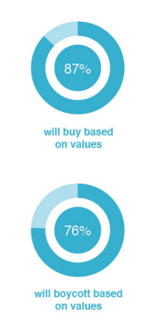
Benefits of Cause Marketing
Benefits for Social Enterprises
Cause marketing has particular benefits for social enterprises and non-profits.
Since non-profits usually have a lower budget for marketing, partnering with a company allows them to tap into a larger audience and customer base. This allows them to reach a customer base that they may not otherwise reach (MailChimp, 2019).
Partnering with a company that has a similar customer base or industry as your social enterprise can be beneficial. Social enterprises that focuses on education of young people might be better partnering with a company whose core customer base is young people for example.
Many social enterprises and non-profits directly offer cause marketing opportunities to companies who may wish to partner with them, some examples below:
Barretstown (adventure camps catered for children with serious illness)
Alone (a charity aimed at combating isolation amongst older people)
Image source: (Cone Communications, 2017) https://www.cbd.int/doc/case-studies/inc/cs-inc-cone-communications-en.pdf

Slide 15
Propose a Partnership
Activity 2
Split into 2 equal groups.
Group 1 – You run your own social enterprise focused on intergenerational learning.
Group 2 – You run your own social enterprise related to older people's mental health and wellbeing.
Recently you have decided you would like to partner with a company to engage in a cause-related marketing campaign after seeing the success of Jigsaw & Lidl's partnership.
You have the next 30 minutes to identify an existing company that you would like to partner with and identify the benefits of this company partnering with your social enterprise.
After 30 minutes, you are going to present your proposal to the other group who will act as the company you have chosen.

Slide 16
Unit 3 Implementing Cause Marketing

Slide 17
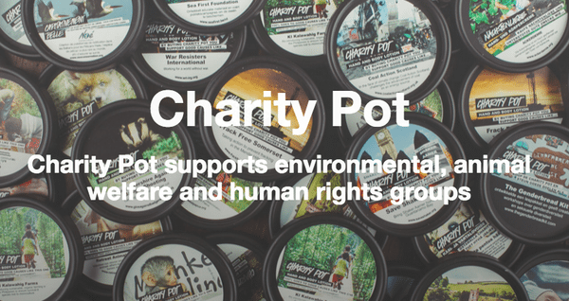
Implementing cause marketing
To best implement cause marketing for your social enterprise, there are four main steps:
Partner with a company related to your cause – partnerships that are relevant to both companies make the most sense, for example Cheerios Childline Breakfast, or Lush (cosmetics/skincare company) pairing with animal welfare charities.
Define your contribution – not every cause needs monetary contributions, and money is not the only way that a company can help a cause. Many brands engage in other cause marketing strategies such as:
Planned events
Donating products and/or services
Advertising campaigns
Email marketing campaigns
Image sources: https://www.giraffe.ie/wp-content/uploads/2016/11/cheerios2016-e1478514502937.png
https://fundraising.co.uk/wp-content/uploads/2021/06/rsz_screen_shot_2016-08-29_at_200329-1.png

Slide 18
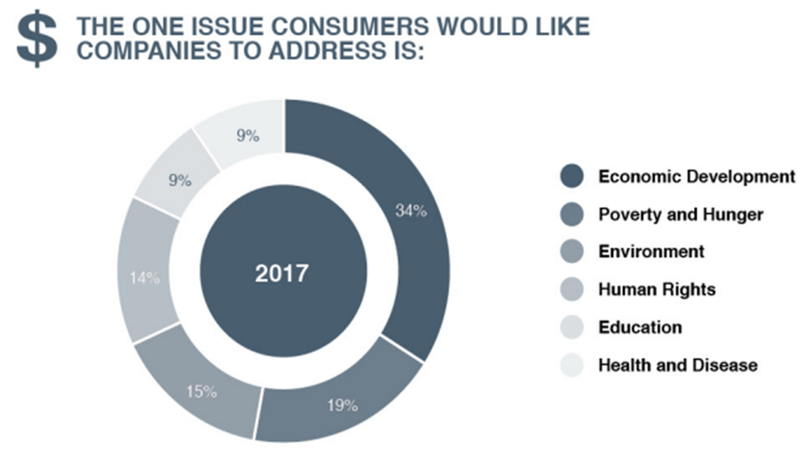
Implementing cause marketing
3. Plan your marketing efforts – once you have determined how you wish to contribute, you must plan how you are going to market your efforts.
Several channels such a social media, local radio, paper advertising, as well as word-of-mouth can be used to promote the campaign. For social enterprises, this is the most important step as this generates the most awareness for your enterprise.
4. Include your customer base – gear your charitable efforts towards your customer base.
This can be done through a variety of different methods such as asking customers to share posts about your campaign on social media, selling products or asking for donations, offering discounts for contributions made towards your campaign, and inviting customers to participate in planned events among others.
Partner with a company related to your cause
Define your contribution
Plan your marketing efforts
Include your customer base
Image source: (Cone Communications, 2017) https://www.cbd.int/doc/case-studies/inc/cs-inc-cone-communications-en.pdf

Slide 19
Create Your Own Cause Marketing Campaign
Activity 3
Split into 2 equal groups.
Group 1 – You run your own social enterprise focused on intergenerational learning.
Group 2 – You run your own social enterprise related to older people's mental health and wellbeing.
Using the company that you identified in Activity 2, you are now going to propose your own cause marketing campaign.
You have the next 40 minutes to draft and present your own cause marketing campaign to propose to the company. In this draft you must:
Define the method of contribution
A marketing strategy to promote the partnership
Include a way in which consumers can participate

Slide 20
Thank you! Follow us at https://empower-project.net/ https://www.facebook.com/empowerproject.eu/

Slide 21
References
Cone Communications. (2017). Corporate Social Responsibility Study 2017. Boston: Cone Communications.
Fritz, J. (2021, February 26). What Every Nonprofit Should Know About Cause Marketing. Retrieved from Small Business: https://www.thebalancesmb.com/what-every-nonprofit-should-know-about-cause-marketing-2502005
Indeed Editorial Team. (2022, June 28). What is Cause Marketing? Definition and How to Build a Campaign. Retrieved from Indeed: https://www.indeed.com/career-advice/career-development/what-is-cause-marketing
MailChimp. (2021). What Is a Cause Marketing Campaign? Retrieved from Intuit MailChimp: https://mailchimp.com/resources/what-is-cause-marketing/
Moore, K. (2020, December 4). Cause Marketing: What It Is, How to Do It, and Why it Matters. Retrieved from Shopify: https://www.shopify.ie/retail/cause-marketing
O'Dougherty, K. (2021). How Nonprofits Find Success with Cause-Related Marketing. Retrieved from Nonprofit Megaphone: https://nonprofitmegaphone.com/cause-related-marketing/
Organ, M. (2017, May 23). Cause Marketing - Definition. Retrieved from CauseMarketing.com: https://causemarketing.com/research/cause-marketing-definition/
Schaeffer, L. (2019, October 2). Consumers Expect the Brands They Support to be Socially Responsible. Retrieved from BusinessWire: https://www.businesswire.com/news/home/20191002005697/en/Consumers-Expect-Brands-Support-Socially-Responsible

